Slide 1
UTERINE FIBROIDS
DR. L. GIRIJA. M.D. (Hom.),
Associate professor,
DEPARTMENT OF GYNAECOLOGY AND OBSTETRICS,
SARADA KRISHNA HOMOEOPATHIC MEDICAL COLLEGE,
KULASEKHARAM

Slide 2
INTRODUCTION
Uterine leiomyomas are the most common gynaecological tumours and are present in 30% of women of reproductive age.

Slide 3
Synonyms
Leiomyoma of uterus
leiomyomas
Fibromyomas
Myofibromas
Fibroids
Fibromas
Myomas

Slide 4
Uterine Tumors Classification:
Endometrial tumors
Benign - Endometrial polyps
Malignant – Endometrial Carcinoma
Myometrial tumors
Benign – Leiomyoma
Malignant – Leiomyosarcoma
Tumor like conditions
Adenomyosis
Endometriosis
Gestational & Placental Tumors
Hydatidiform mole – Partial & complete.
Choriocarcinoma

Slide 5
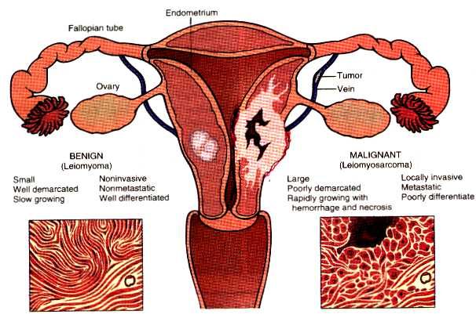

Slide 6
Incidence
Most common solid pelvic tumors
Develop in 20-25% of women during reproductive years 30-50 years old
Common in blacks.
Childbearing life.
Often enlarge during pregnancy or
during oral contraceptive use, and regress after menopause
Occur in women of reproductive age, often

Slide 7
‘‘Uterus deprived from a baby consoles itself with a fibroid’’

Slide 8
Causes
Unknown.
Hyperestrogenemia.
Infertility
Mechanical stress

Slide 9
Microscopic Appearance
Composition- smooth muscle connective tissue
The non striated muscle fibers are arranged in bundles of various sizes that run in multiple directions.

Slide 10
Classification
According to growth location
Myomas onthebodyofuterus90%
Myomas on the cervix of uterus 10%

Slide 11
Classification
According to the relation to uterine muscle
Submucous 10-15%
Intramural 60-70%
Subserosal 20%

Slide 12
Uterine leiomyoma
Cervical
1-2%
solitary
Corporeal
98%
multiple

Slide 13
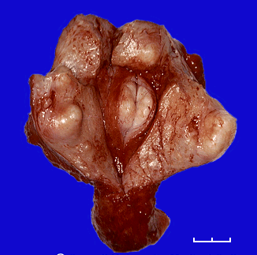

Slide 14
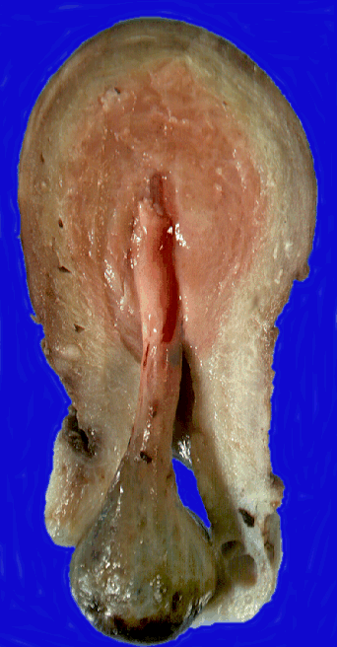

Slide 15
Corporeal leiomyoma
submucus
24%
not capsulated
Subserous
18%
Interstitial
58%

Slide 16
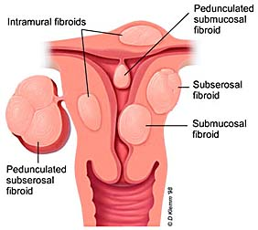

Slide 17
SYMPTOMS
Bleeding (menorrhagia-metrorrhagia).
Pain uncomplicated (cong. Dysmenorrhea – dull - colicky).
Pain complicated deg.-malig.-infection-torsion)
Mass.
Discharge.
Pressure symptoms.
Spontaneous abortion
Infertility

Slide 18
CLINICAL FEATURES
The vast majority of leiomyomas are asymptomatic.
The most common symptom of uterine leiomyoma is abnormal uterine bleeding.
In 30% of women suffered from menorrhagia.

Slide 19
CLINICAL FEATURES
The mechanism of fibroid-associated menorrhagia is unknown.
Vascular defects,
Submucous tumours, and
Impaired endometrial hemostasis have been offered as possible explanations.

Slide 20
CLINICAL FEATURES
Pelvic pain is rare with fibroids and it usually signifies degeneration, torsion, or, possibly, associated adenomyosis.
Pelvic pressure,
bowel dysfunction, and
bladder symptoms such as urinary frequency and urgency may be present.

Slide 21
CLINICAL FEATURES
Urinary symptoms should be investigated prior to surgical management of fibroids to exclude other possible causes.

Slide 22
CLINICAL FEATURES
In the postmenopausal woman presenting with pain and fibroids, leiomyosarcoma should be considered.

Slide 23
PATHOLOGY
Site
shape
size.
Consistency
cut section
capsule
Number
varieties.

Slide 24
CONSISTENCY
Firm
Harder (hyaline degeneration).
Soft (pregnancy-cystic-red- degeneration).
Stony hard (Calcification)

Slide 25
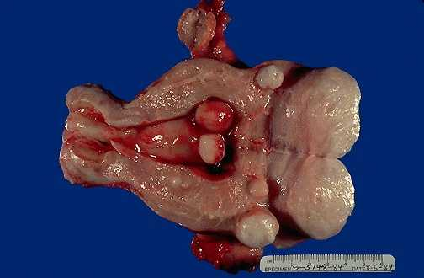
Leiomyomata Uterus

Slide 26
CUT SECTION
Well demarcated surrounding muscle.
whorly (intermingling muscle fibers and fibrous tissue).
Paler than surrounding (Ischaemia).

Slide 27
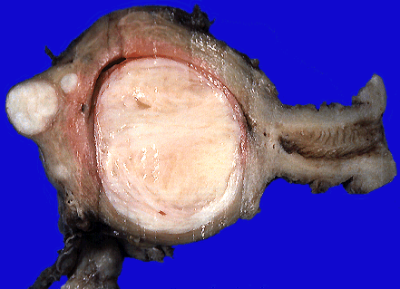

Slide 28
Microscopic Examination
Smooth muscle cells and fibrous tissue cells.
Few formed blood vessels.

Slide 29
Tumour itself
Atrophy.
Degeneration (hayline - red - cystic - fatty-calcarious)
Necrosis.
Malignancy (growth after menopause-rapid enlargement-recurrent fibroid polyp).
Vascular (oedema - lymphangectasia)
Infection.

Slide 30
Degeneration
Leiomyomas enlarge outgrow their blood supply various types of degeneration
Hyaline degeneration
Cystic degeneration
Red degeneration
Myxoid degeneration
Sarcomatous change
The others fat degeneration
calcification
the secondary infection
Result from the diminished
vascularity of the
connective-tissue element

Slide 31
Degeneration
Hyaline degeneration :- the presence of homogeneous eosinophilic bands or plaques in the extracellular space.
Myxoid degeneration - presence of gelatinous intratumoral foci at gross examination that contain hyaluronic acid–rich mucopolysaccharides

Slide 32
Sarcomatous Change
Rare 0.4% 0.8%
More common at 40-50 years old
Usually occur in intramural fiboids grow quickly
vaginal bleeding

Slide 33
Red Degeneration
Occasionally seen as a complication of pregnancy during pregnancy or immediate postpartum period
The pathogenesis is unknown may be the result of the accumulation of blood in the tumour because of venous obstruction.
secondary to venous thrombosis within the periphery of the tumor or rupture of intratumoral arteries
The cut surface resembles raw meat.
Clinical features a cause of pain acute
fever
rapid growth tenderness

Slide 34
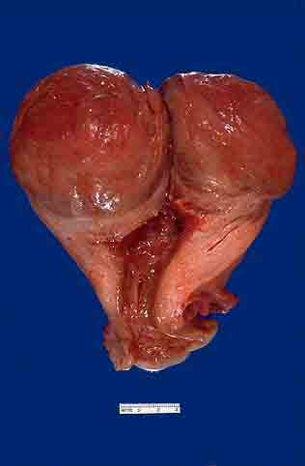
Red Degeneration
Here is a very large leiomyoma of the uterus that has undergone degenerative change and is red (so-called "red degeneration"). Such an appearance might make you think that it could be malignant. Remember that malignant tumors do not generally arise from benign tumors.

Slide 35
Investigations
Clinical
Laboratory
Imaging techniques
Instrumental
Miscellaneous

Slide 36
Diagnosis
History
D.D
Bimanual examination
Ultrasonography
Hysteroscopy
Laparoscopy
Hysterography

Slide 37
Signs
A palpable abdominal tumour
Pelvic examination
uterus — enlarged and irregular hard

Slide 38
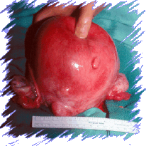
Signs
Symmetrically enlarged uterus(submu cosal fibroid).
Asymmetrically enlarged uterus(subser ous fibroid)

Slide 39
Differential Diagnosis
Pregnancy
Ovarian tumour
Adenomyosis
Malignant tumors of uterus
sarcoma of uterus
endometrial carcinoma
cervical cancer

Slide 40
Treatment of Leiomyoma
No treatment
Conservative
Radiological
Surgical
Myolysis.
GNRHA
Uterine artery embolization.
Patient (age-parity-symptoms).
Fibroid (number-size-type)
Complications.

Slide 41
Observation and Follow Up
Small asymptomatic fibroids need not be treated especially near menopause.
Interval 3-6 months

Slide 42
SURGICAL
Myomectomy
Polypectomy.
Hysterectomy.
(traditional- microsurgical).

Slide 44
Surgery Treatment
Indications
Greater than 10 weeks’ gestational size
Menorrhagia lead to anemia
Have pressure symptoms
Grows rapidly
Failure of medical treatment

Slide 45
Surgery Treatment
Myomectomy—conservative therapy
preserve fertility
significant risk of recurrence
Hysterectomy— radical therapy
Subtotal hysterectomy

Slide 46
Surgery Treatment
Approach
Trans-abdominal
Trans-vaginal
Laparoscopic or hysteroscopic

Slide 47
Uterine Leiomyomas Complicating Pregnancy
Impact on pregnancy：
abortion
Impact on delivery：premature labour
fetal malpresentation
retained placenta
placenta previa
need for operative delivery
（birth canal obstruction）
postpartum hemorrhage
Conservative treatment

Slide 48
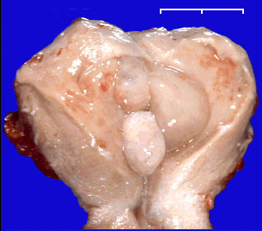

Slide 49
MYOMECTOMY THROUGH A LAPAROTOMY INCISION
Although myomectomy allows preservation of the uterus, available data suggest a:
Higher risk of blood loss and
Greater operative time with myomectomy than with hysterectomy.

Slide 50
MYOMECTOMY THROUGH A LAPAROTOMY INCISION
The risk of ureteric injury may be decreased with myomectomy.
There is a 15% recurrence rate for fibroids and
10% of women undergoing a myomectomy will eventually require hysterectomy within 5 to 10 years.

Slide 51
LAPAROSCOPIC MYOMECTOMY
For several pelvic disorders, gynaecologists have resorted to minimal access surgery in an effort to:
Reduce hospital stay and
Improve recovery time.

Slide 52
HYSTEROSCOPIC MYOMECTOMY
Intracavitary or submucous myomas have been observed in 30% of outpatient diagnostic hysteroscopies in women with abnormal uterine bleeding.

Slide 53
HYSTEROSCOPIC MYOMECTOMY
Indications include :
Infertility,
Repeated pregnancy losses, and
Abnormal uterine bleeding.

Slide 54
HYSTEROSCOPIC MYOMECTOMY
The pregnancy rate in women undergoing in vitro fertilization (IVF) may be reduced when myomas are submucosal or when they distort the uterine cavity.

Slide 55
HYSTERECTOMY
The only indications for hysterectomy in a woman with completely asymptomatic fibroids are:
Rapidly enlarging fibroids or,
When enlarging fibroids raise concerns of leiomyosarcoma (after menopause).

Slide 56
HYSTERECTOMY
In women who have completed childbearing, hysterectomy is indicated as a permanent solution for leiomyomas causing substantial bleeding, pelvic pressure, or anemia.

Slide 57
HYSTERECTOMY
Leiomyomas rarely cause pelvic pain, and therefore, if pain is a major symptom, other causes should be excluded.

Slide 58
FIBROIDS AND PREGNANCY
In 4% to 5% of women undergoing prenatal ultrasounds, uterine fibroids are detected.
An increasing number of women are delaying pregnancy until their late thirties, which is also the most likely time for fibroids to develop.

Slide 59
FIBROIDS AND PREGNANCY
Most of these fibroids (80%) remain the same size or become smaller during the pregnancy.
There is conflicting evidence in the literature regarding the impact of fibroids on pregnancy.

Slide 60
FIBROIDS AND PREGNANCY
The risk and type of complication appear to be related to the:
Size,
Number, and
Location of the myomas.

Slide 61
FIBROIDS AND PREGNANCY
If the placenta implants over or in close proximity to a myoma, there may be an increased risk of:
Miscarriage,
Preterm labour,
Abruption,
Prelabour rupture of membranes, or
Intrauterine growth restriction.

Slide 62
FIBROIDS AND PREGNANCY
Fibroids located in the lower uterine segment may increase the likelihood of :
Fetal malpresentation,
Caesarean section, and
Postpartum hemorrhage.

Slide 63
FIBROIDS AND PREGNANCY
Myomectomy should not be performed in pregnant women because of the increased risk of uncontrolled bleeding.
The exception may be symptomatic subserous fibroids on a pedicle less than 5 cm thick, in which case the risk of hemorrhage may be reduced.

Slide 64
ACUTE BLEEDING
Rarely, women with fibroids present with an acute hemorrhage, which can become life-threatening.

Slide 65
ACUTE BLEEDING
High-dose estrogens may help cause vasoconstriction and stabilize the endometrium.
A dilatation and curettage may help slow down the bleeding.

Slide 66
ACUTE BLEEDING
If a submucous fibroid is found prolapsing through the cervix, its removal will usually stop the bleeding.

Slide 67
FIBROIDS IN MENOPAUSE
Fibroids will usually shrink to about half their original size after menopause.

Slide 68
FIBROIDS AND UTERINE LEIOMYOSARCOMAS
A uterine mass increasing in size in a postmenopausal woman suggests a leiomyosarcoma rather than a benign leiomyoma.
Also, leiomyosarcomas tend to be present as a singular large uterine mass or to be confined to the largest of the multiple uterine masses.

Slide 69
FIBROIDS AND UTERINE LEIOMYOSARCOMAS
There is insufficient evidence to support routine biopsy of uterine fibroids.
Magnetic Resonance Imaging (MRI) is promising in distinguishing between benign and malignant smooth muscle tumours.
An ill-defined margin of a uterine smooth muscle tumour on MRI is more in keeping with a malignant process.

Slide 70
THANK YOU

